Slide 1
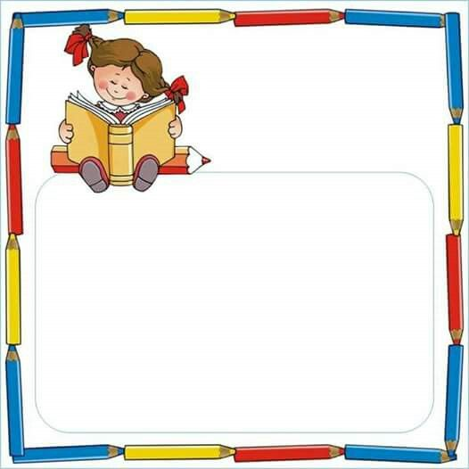
Public School 174 65-10 Dieterle Crescent Rego Park, NY 11374 Phone (718) 897-7006 ps174.org
Mrs. Karin Kelly, Principal Mrs. Kerstin Kobetitsch, A. P.
Moving into “Just-Right” Books
By Kindergarten Teachers
For Kindergarten Parents

Slide 2
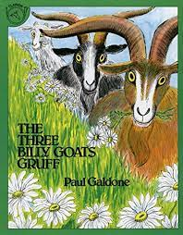
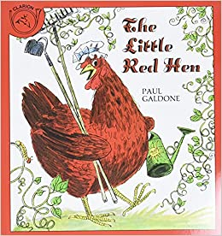
“Star” Books
(Read Alouds, Story Books, Bedtime stories)
Kids “read” the pictures to retell the story .
Kids are not reading the print.
Talk about ...
· Character
· Setting
· Problem/Events
· Solution

Slide 3
Questions Parents Can Ask When Reading Star Books
(Before, During, and After)
Before Reading
After looking at the cover and the pictures, what do you think is going to happen?
Does this book remind you of anything from your life?
During Reading
What do you think will happen next? Why do you think that?
What can you tell me about the story so far?
What emotion do you think the character is feeling? Why do you think that?
How would you feel if that happened to you?
Why do you think the character did that? What would you do if you were in that situation?
Can you put what we just read into your own words?
After Reading
Were your predictions correct?
Who was the story about? Can you tell what happened to them in the beginning, middle, and end?
What questions would you ask the author, if you could?
Is there anything the author/illustrator did that you really liked? How could you try to do that in your writing/reading?

Slide 4
“Just-Right” Books
Also called:
Leveled Books
Children start looking at the print.

Slide 5
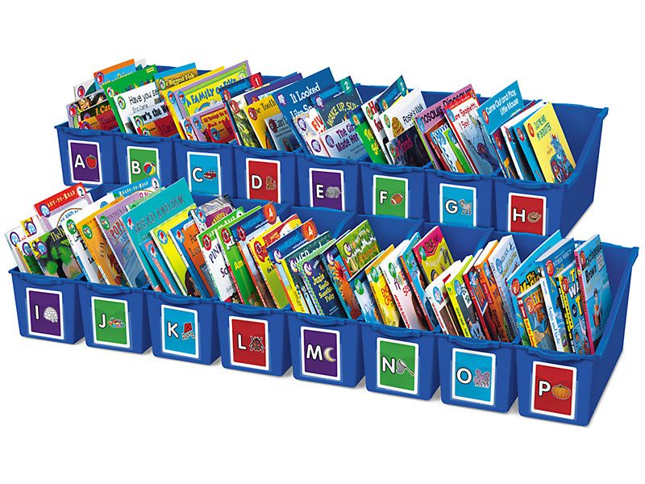
Which books are “JUST RIGHT”?

Slide 6
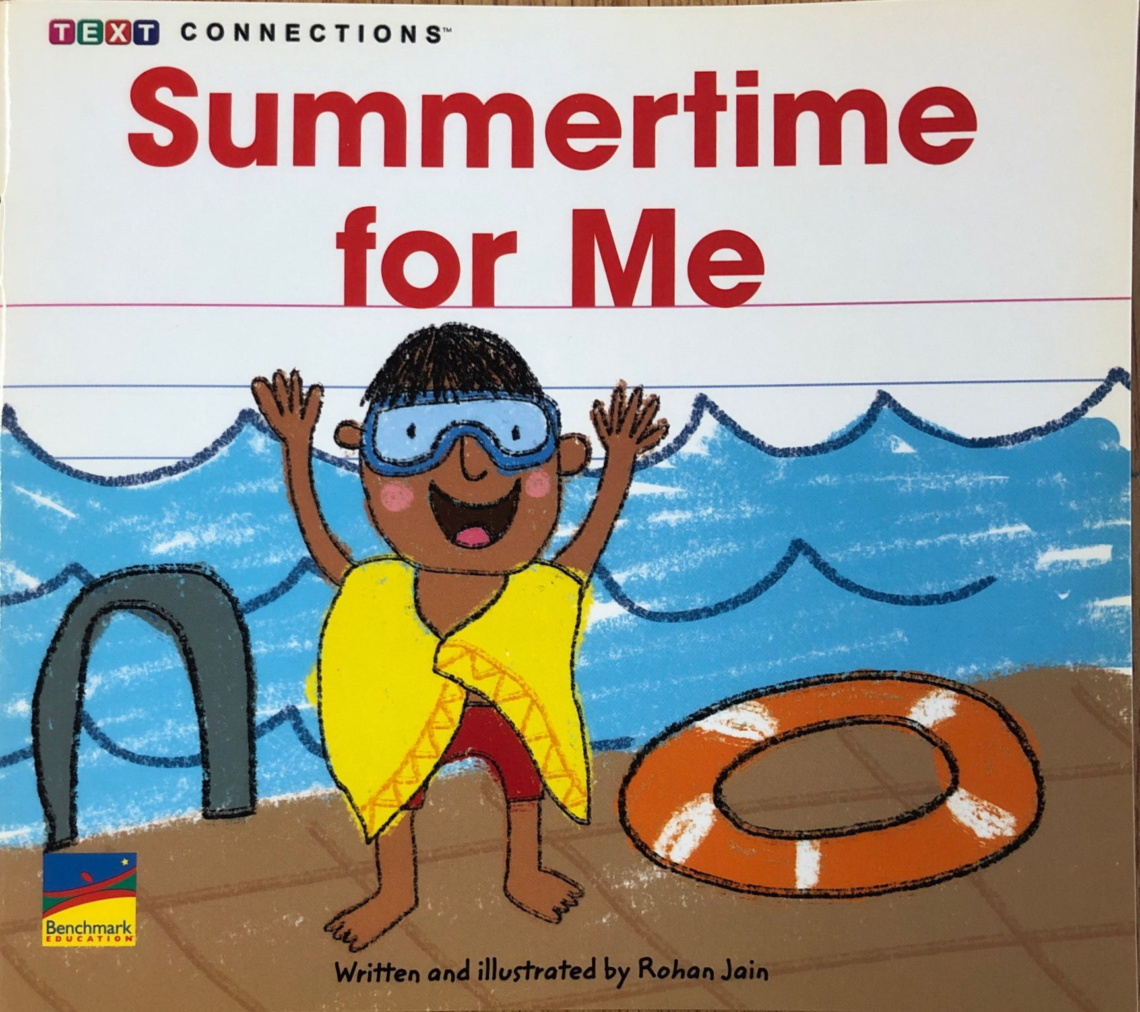
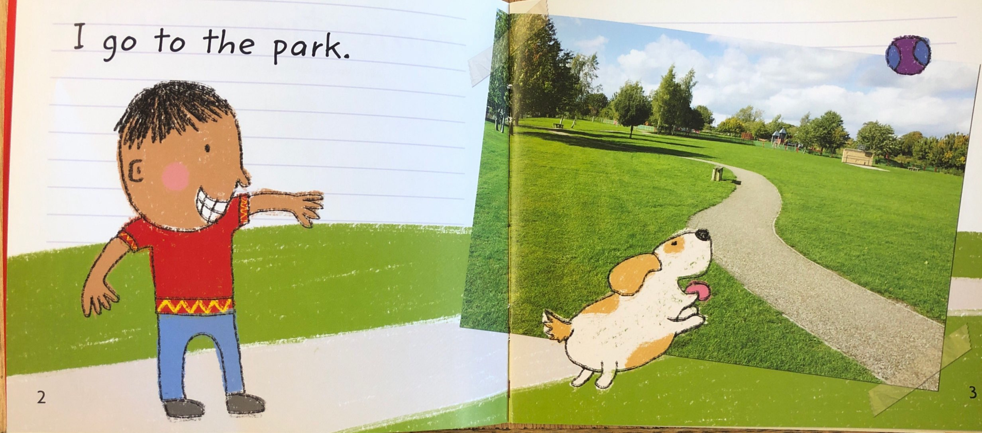
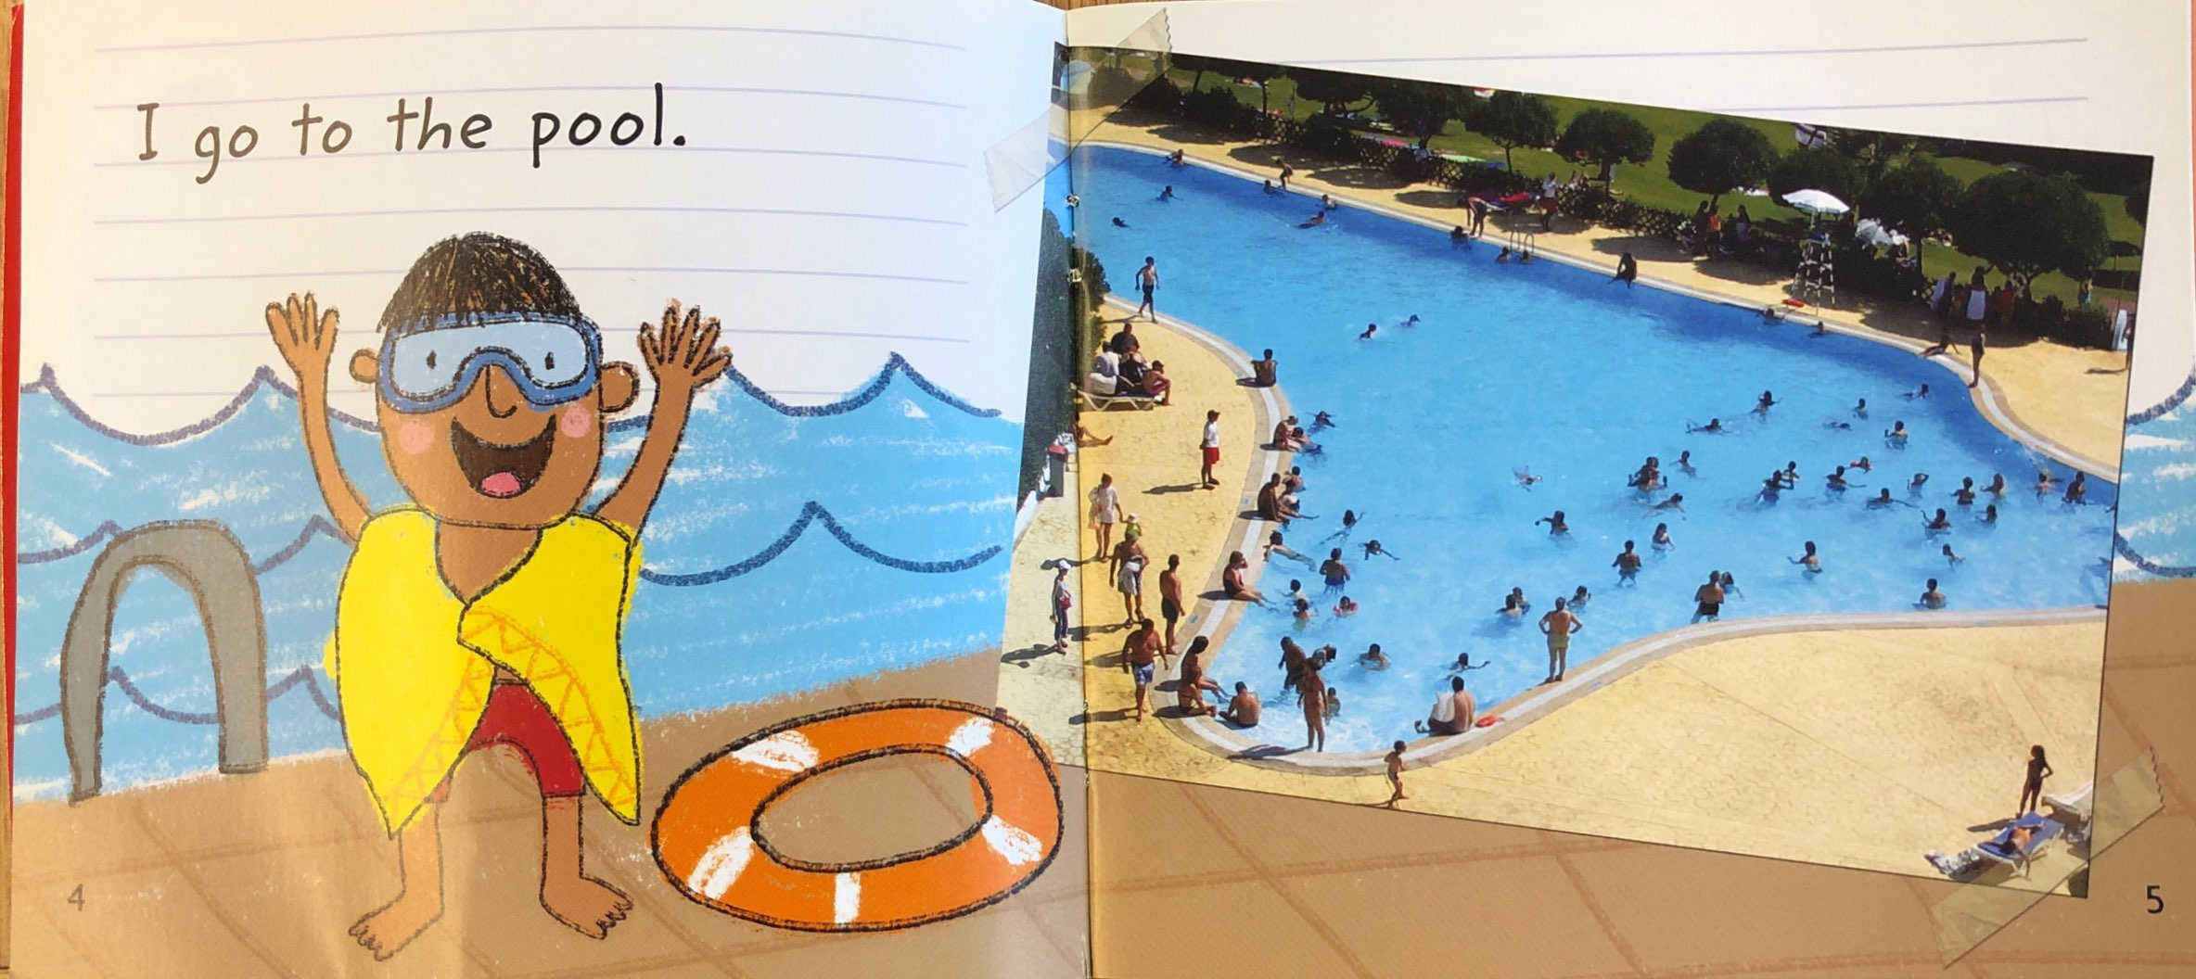
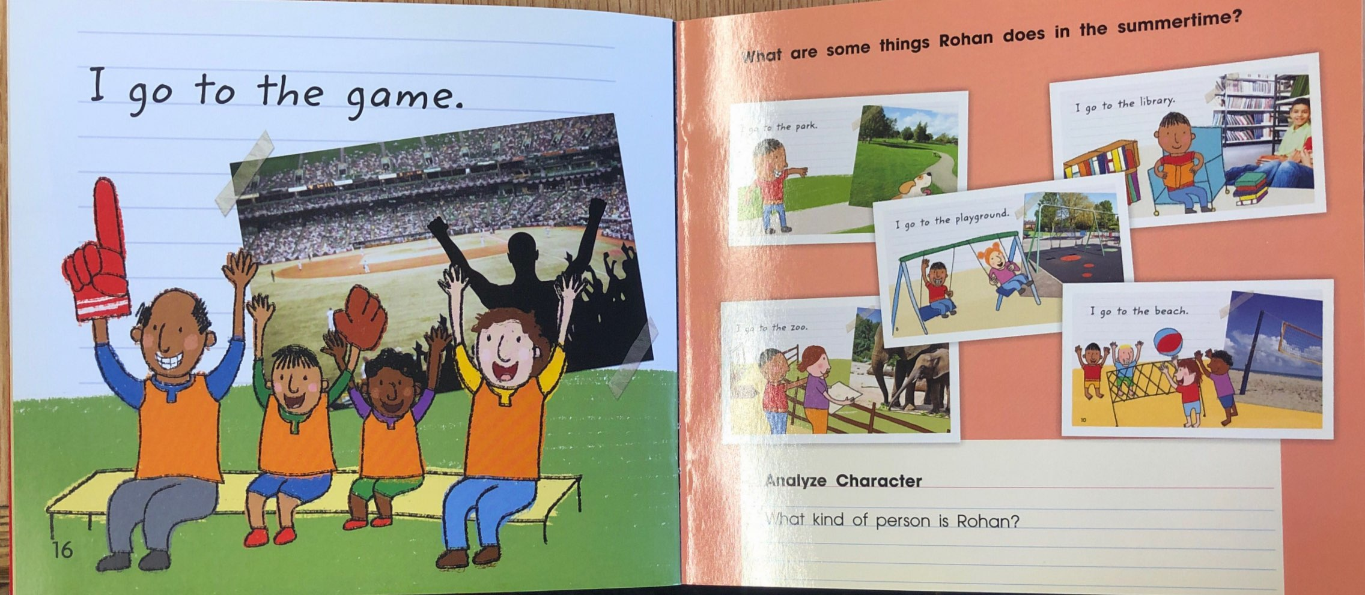
“A” books have a simple pattern on every page.
Example:
I go to the park.
I go to the pool.
I go to the game.

Slide 7
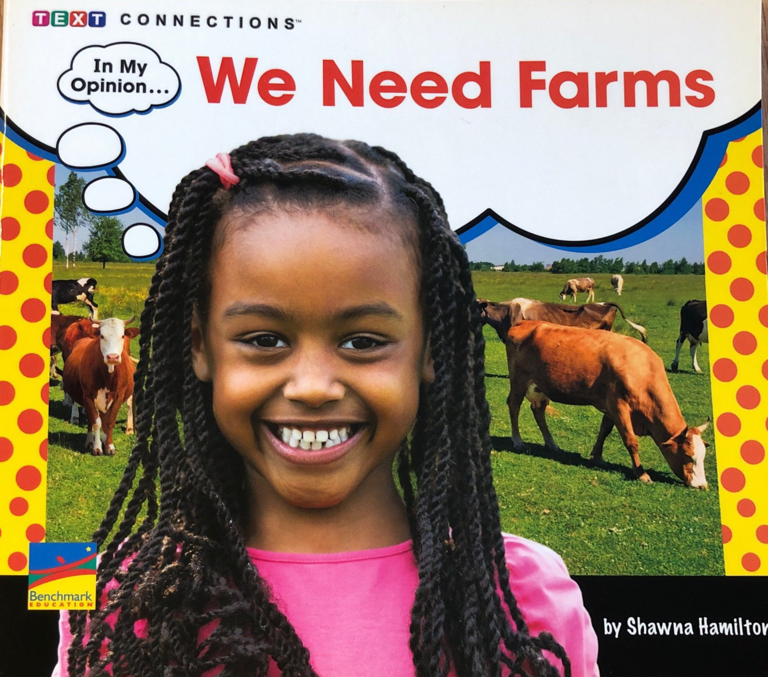
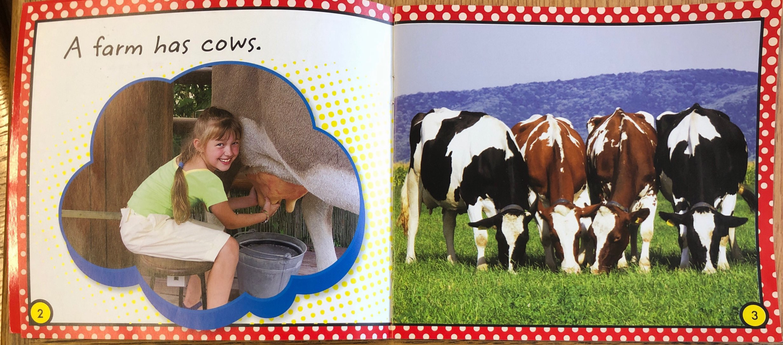
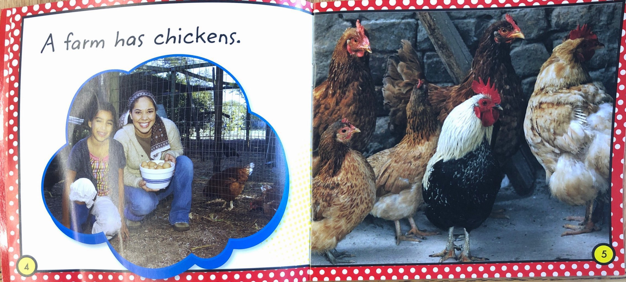
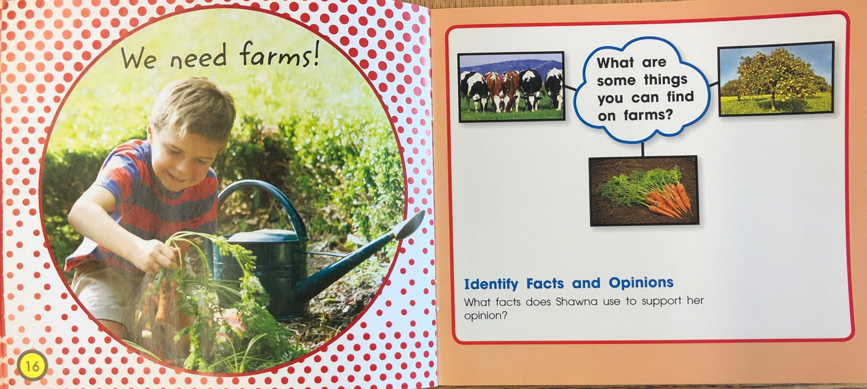
In “B” books, the pattern changes, usually on the last page.
Example:
A farm has cows.
A farm has chickens.
We need farms!

Slide 8
As your child reads an A/B Book they should be able to:
Use the pattern (after an adult reads the first page).
Point under each word.
Use the pictures to help them read.

Slide 9
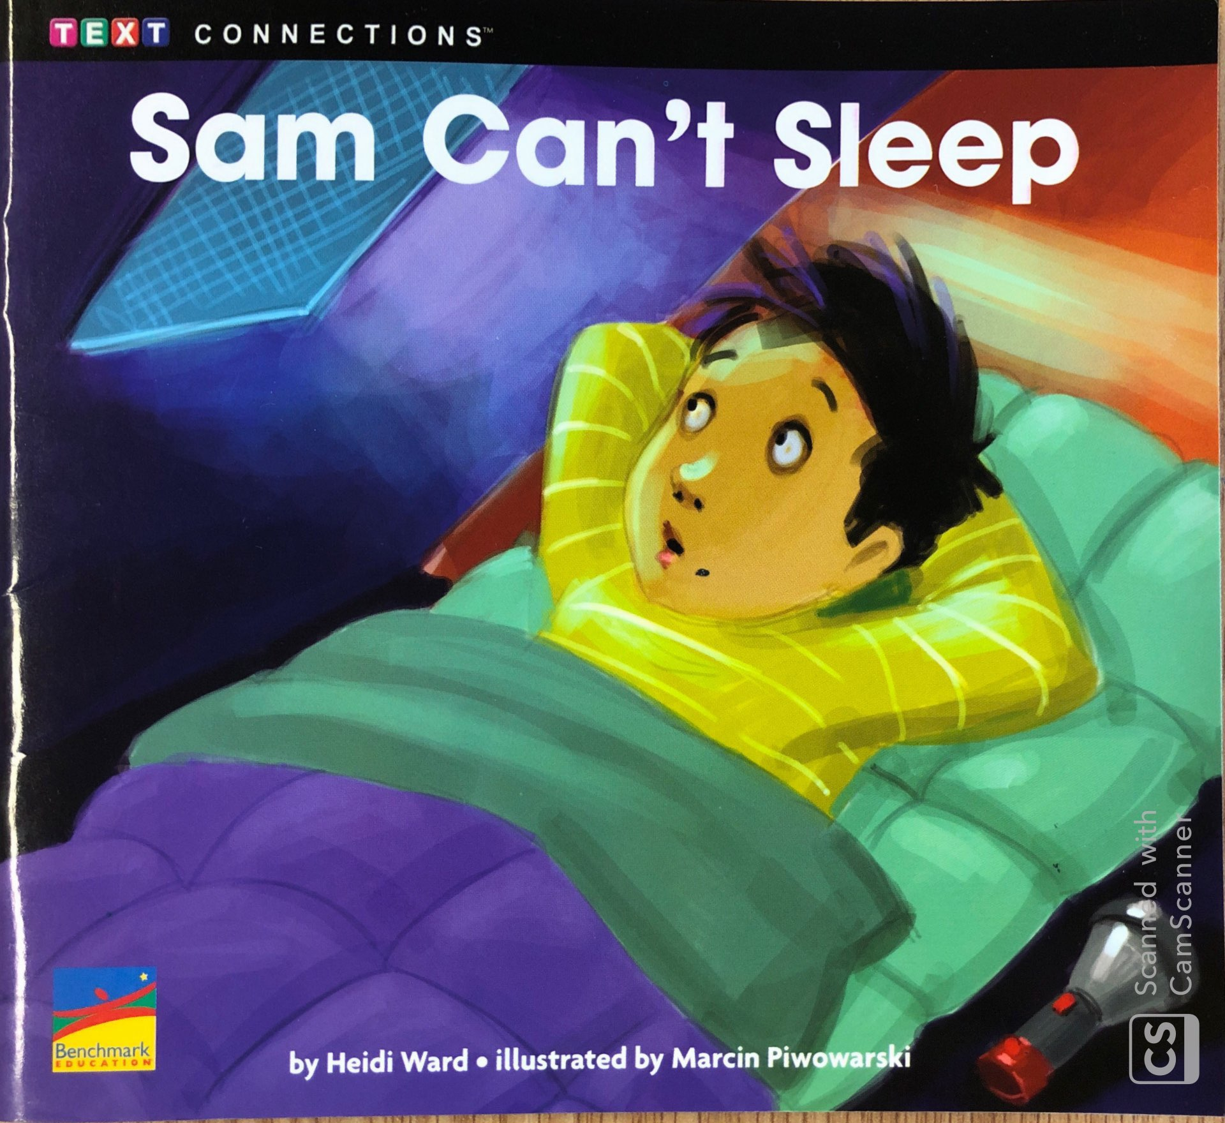
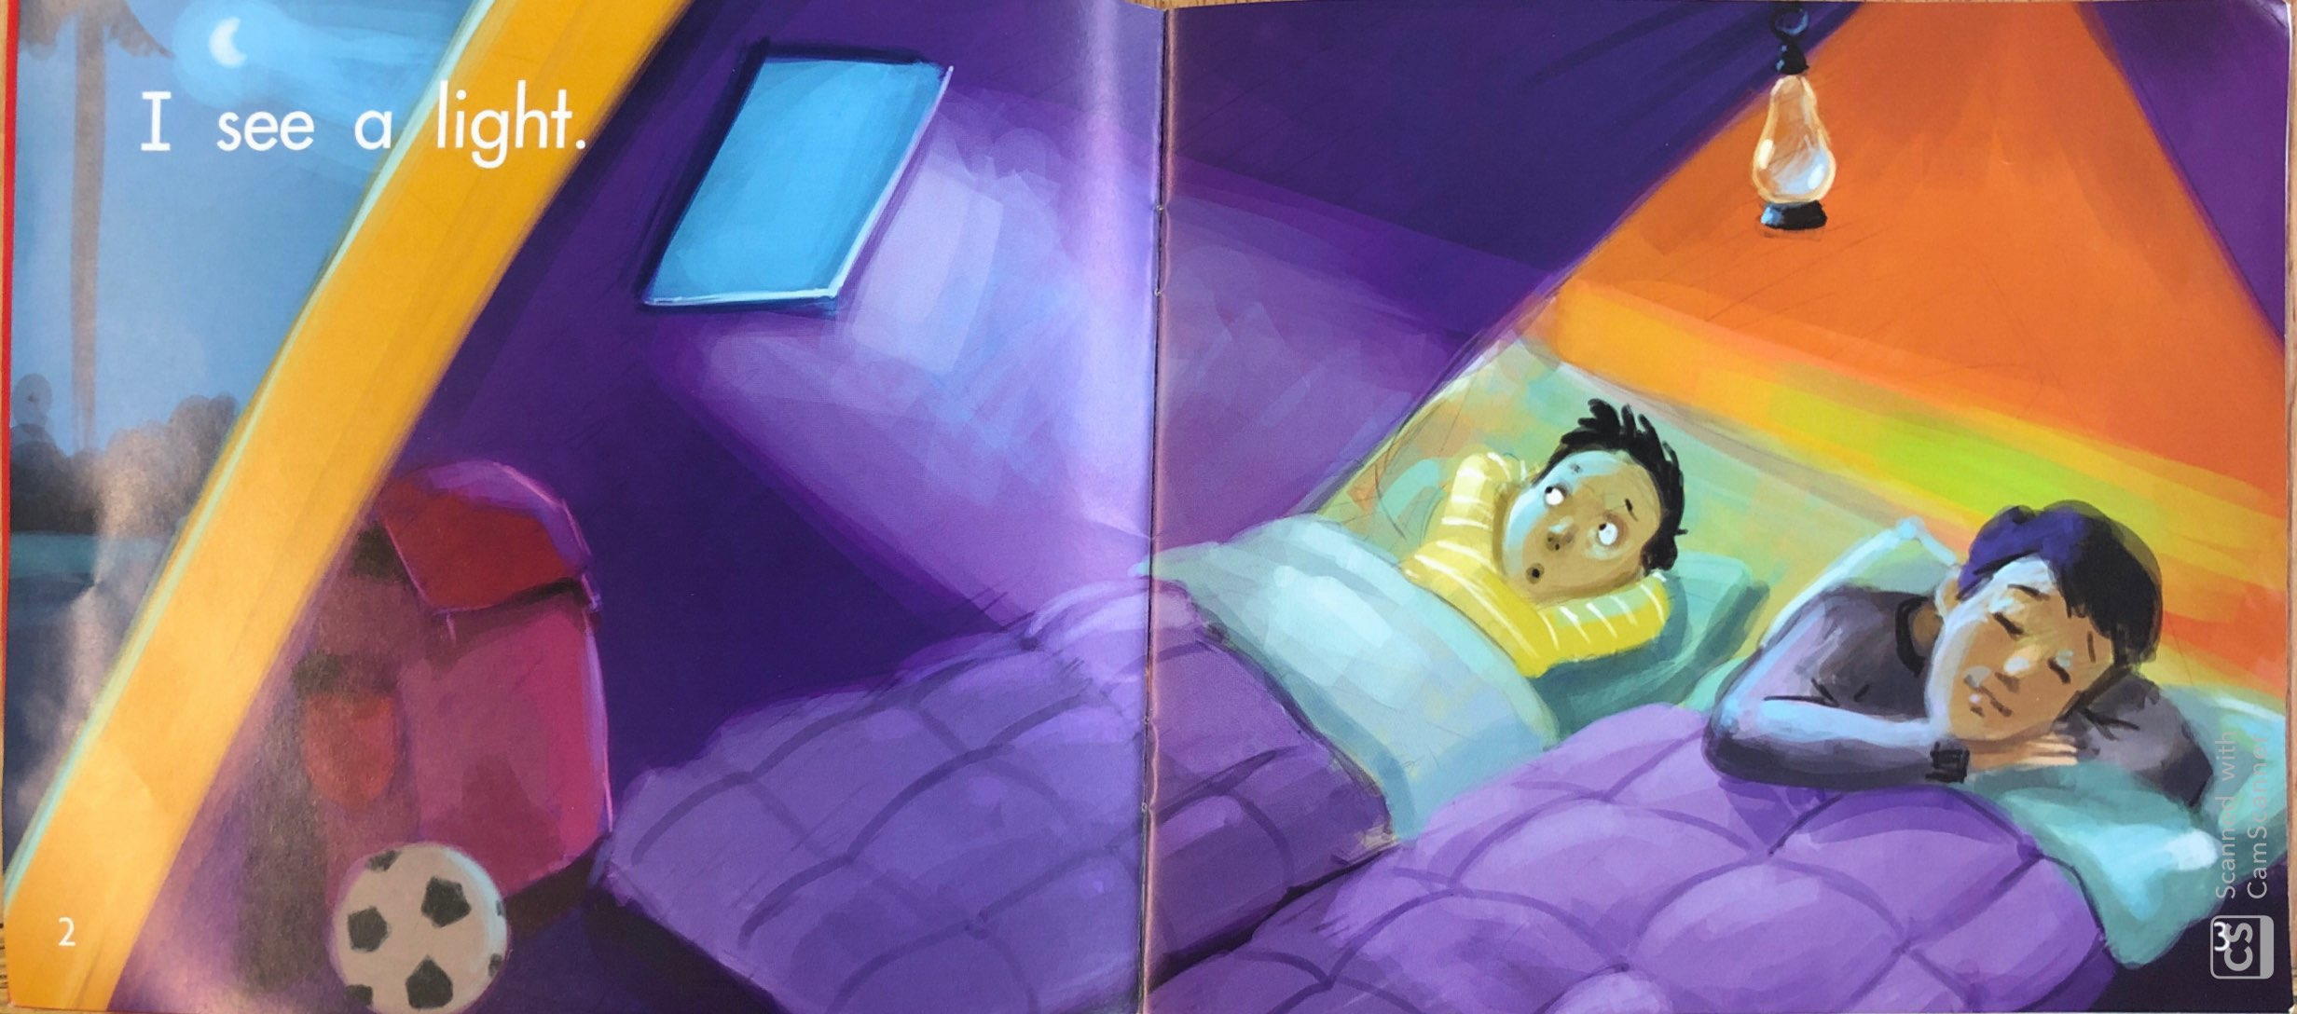
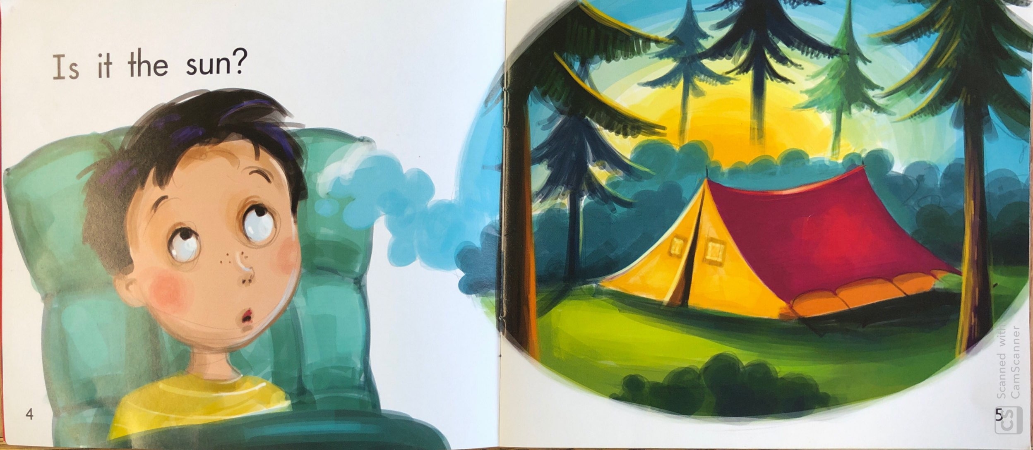
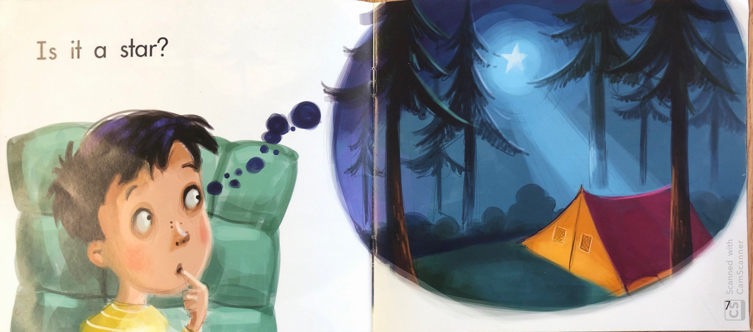
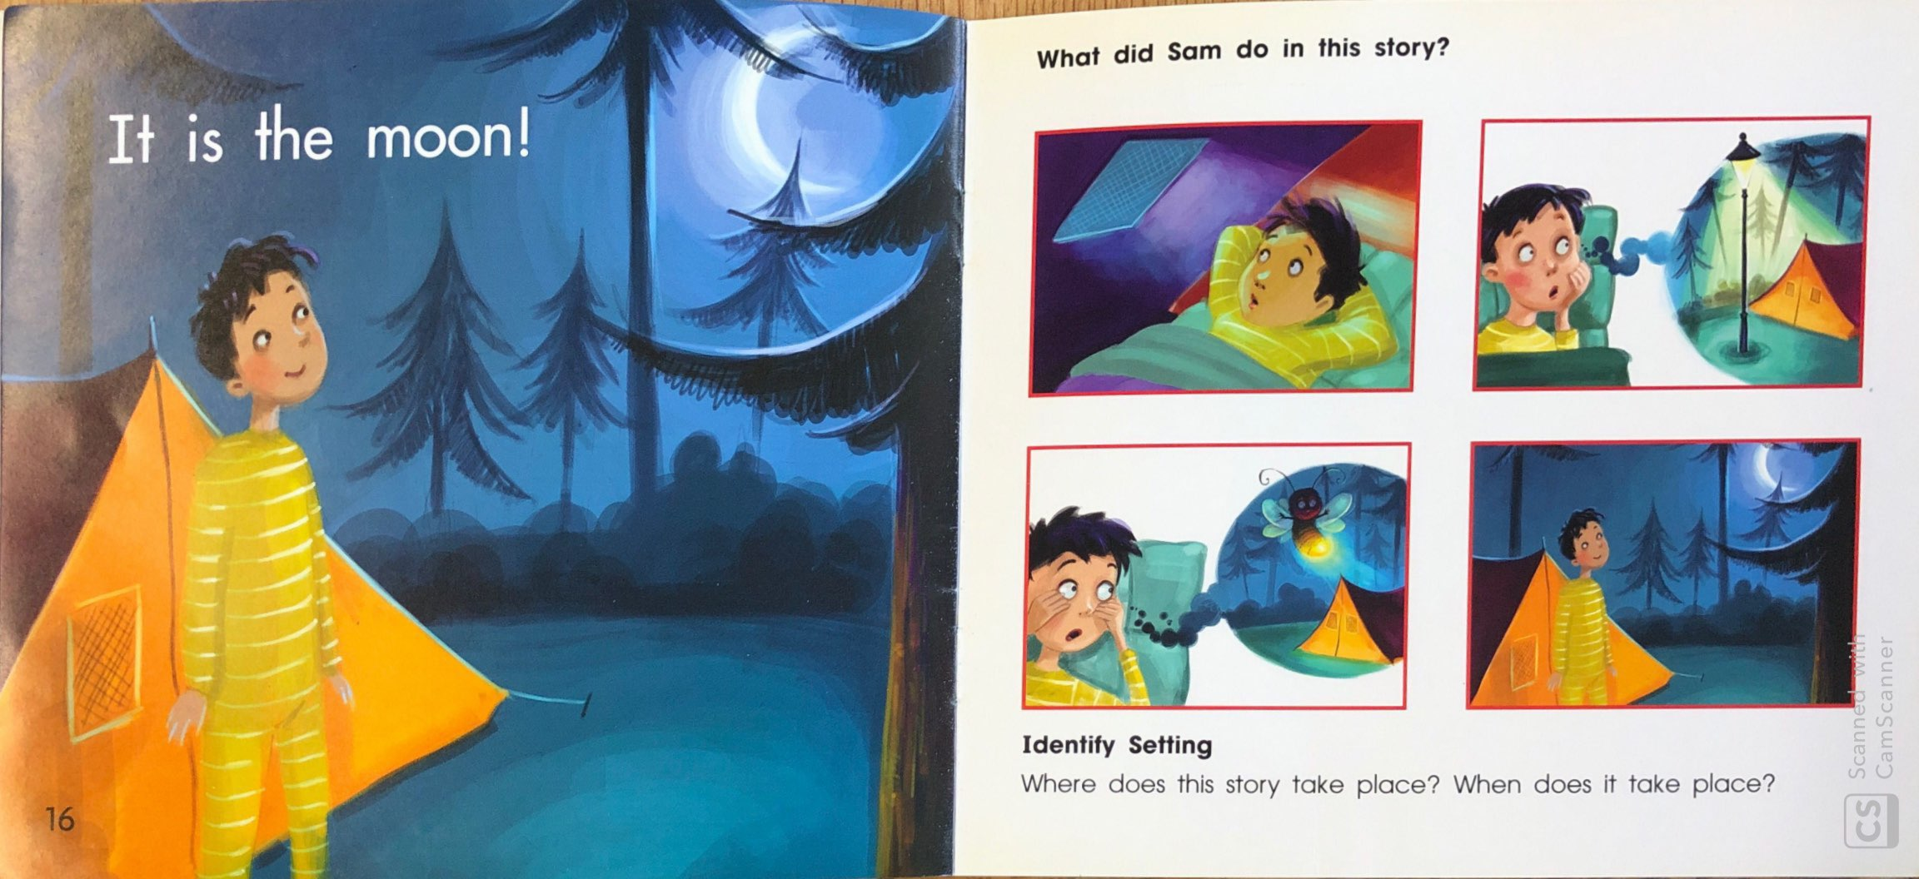
In “C” books, children start using the sounds of letters to figure out “tricky words.”
Example:
I see a light.
Is it the sun?
Is it a star?
It is the moon!

Slide 10
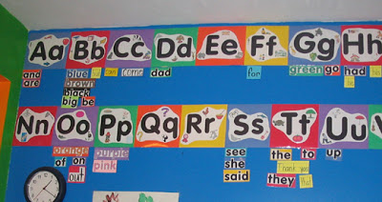
Students start to identify
“sight words”
without sounding them out.

Slide 11
Sight Words
Sight words are common words that students are taught to recognize instantly. These words usually cannot be “tapped or sounded out”. Students learn to recognize them by sight.
https://sightwords.com/sight-words/dolch/#lists

Slide 12
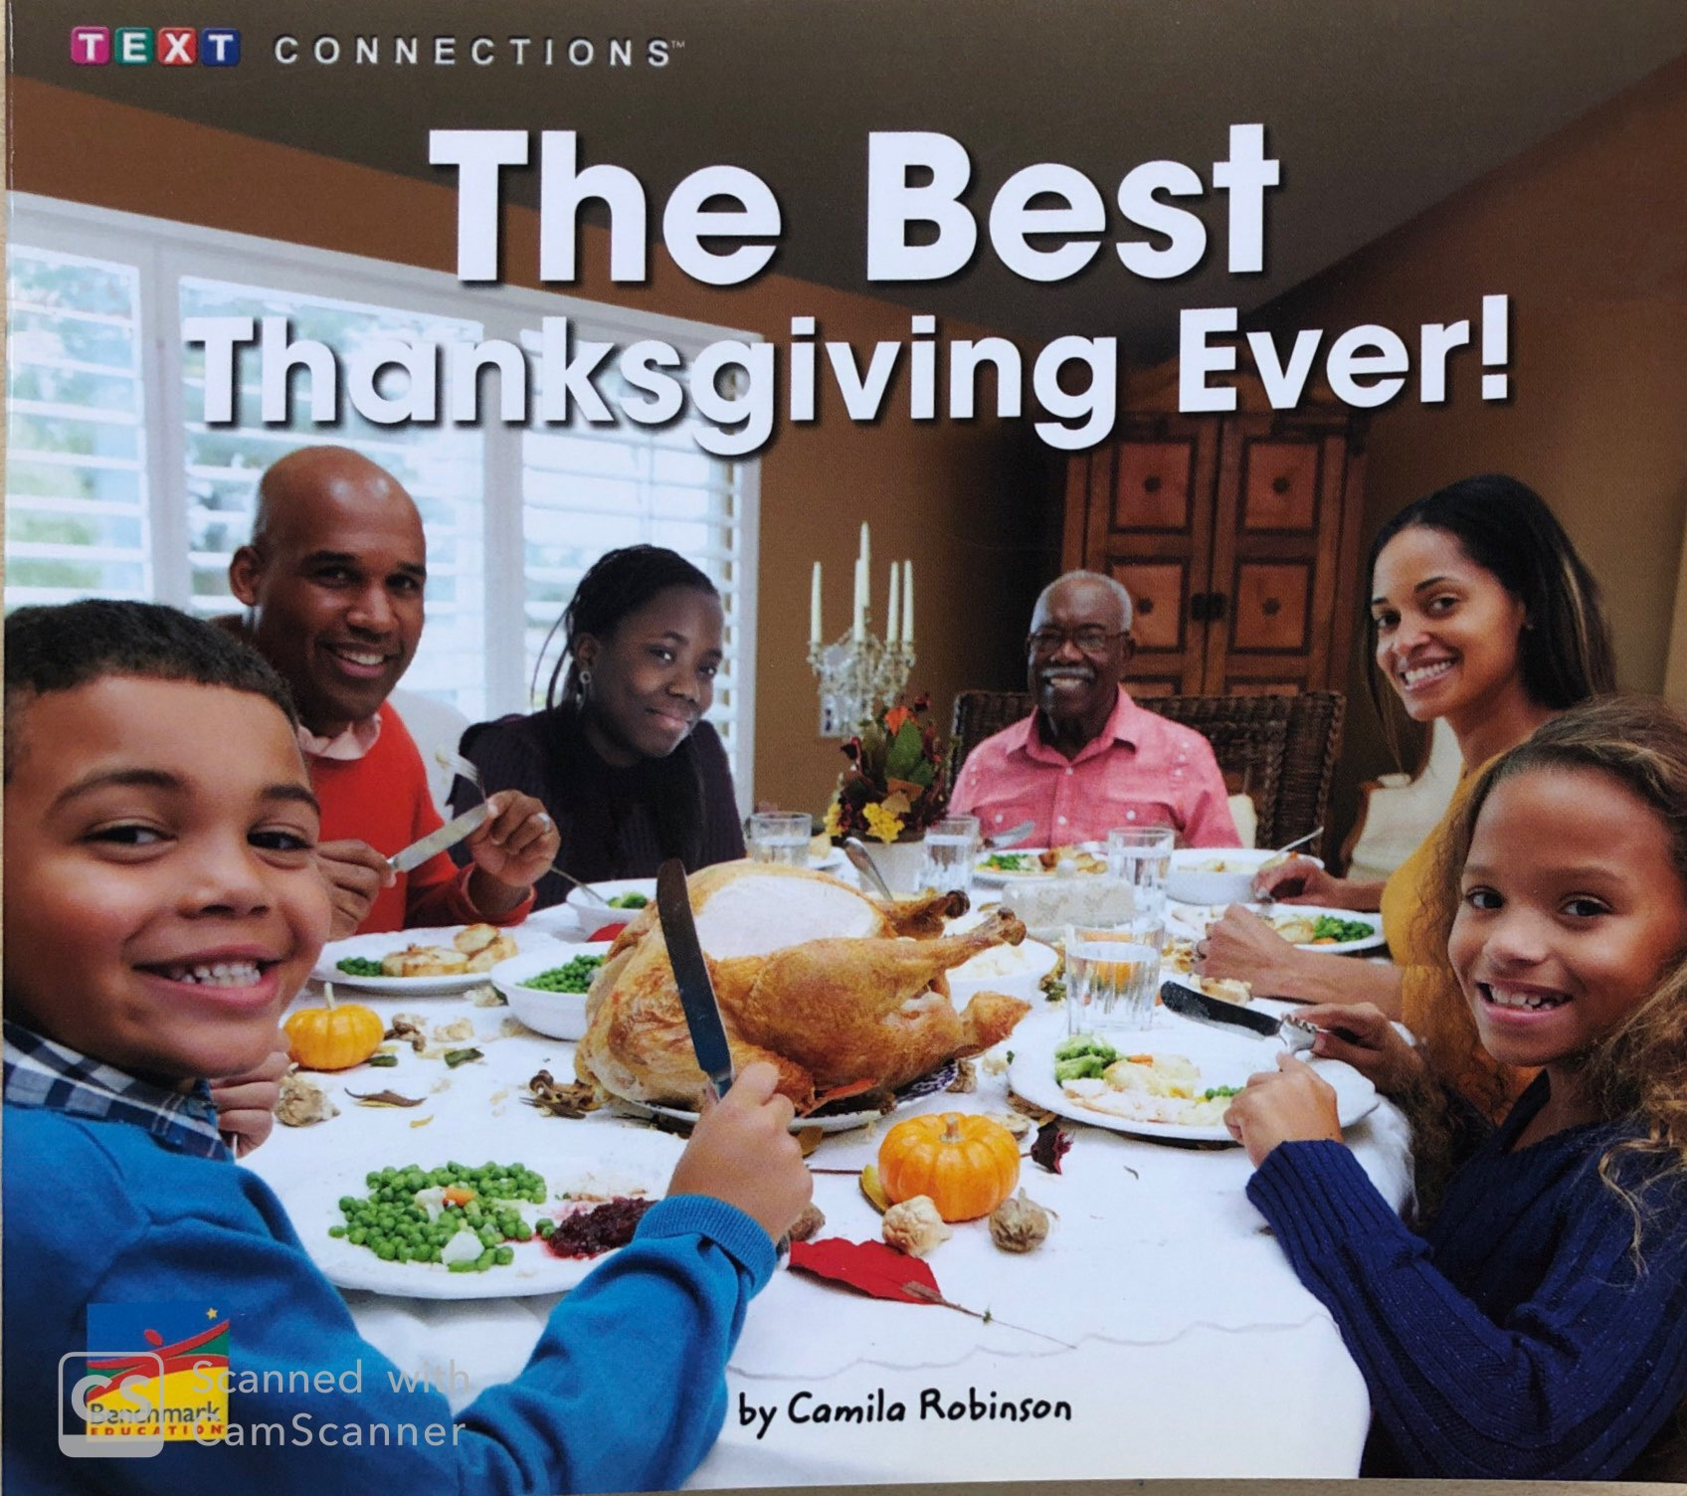
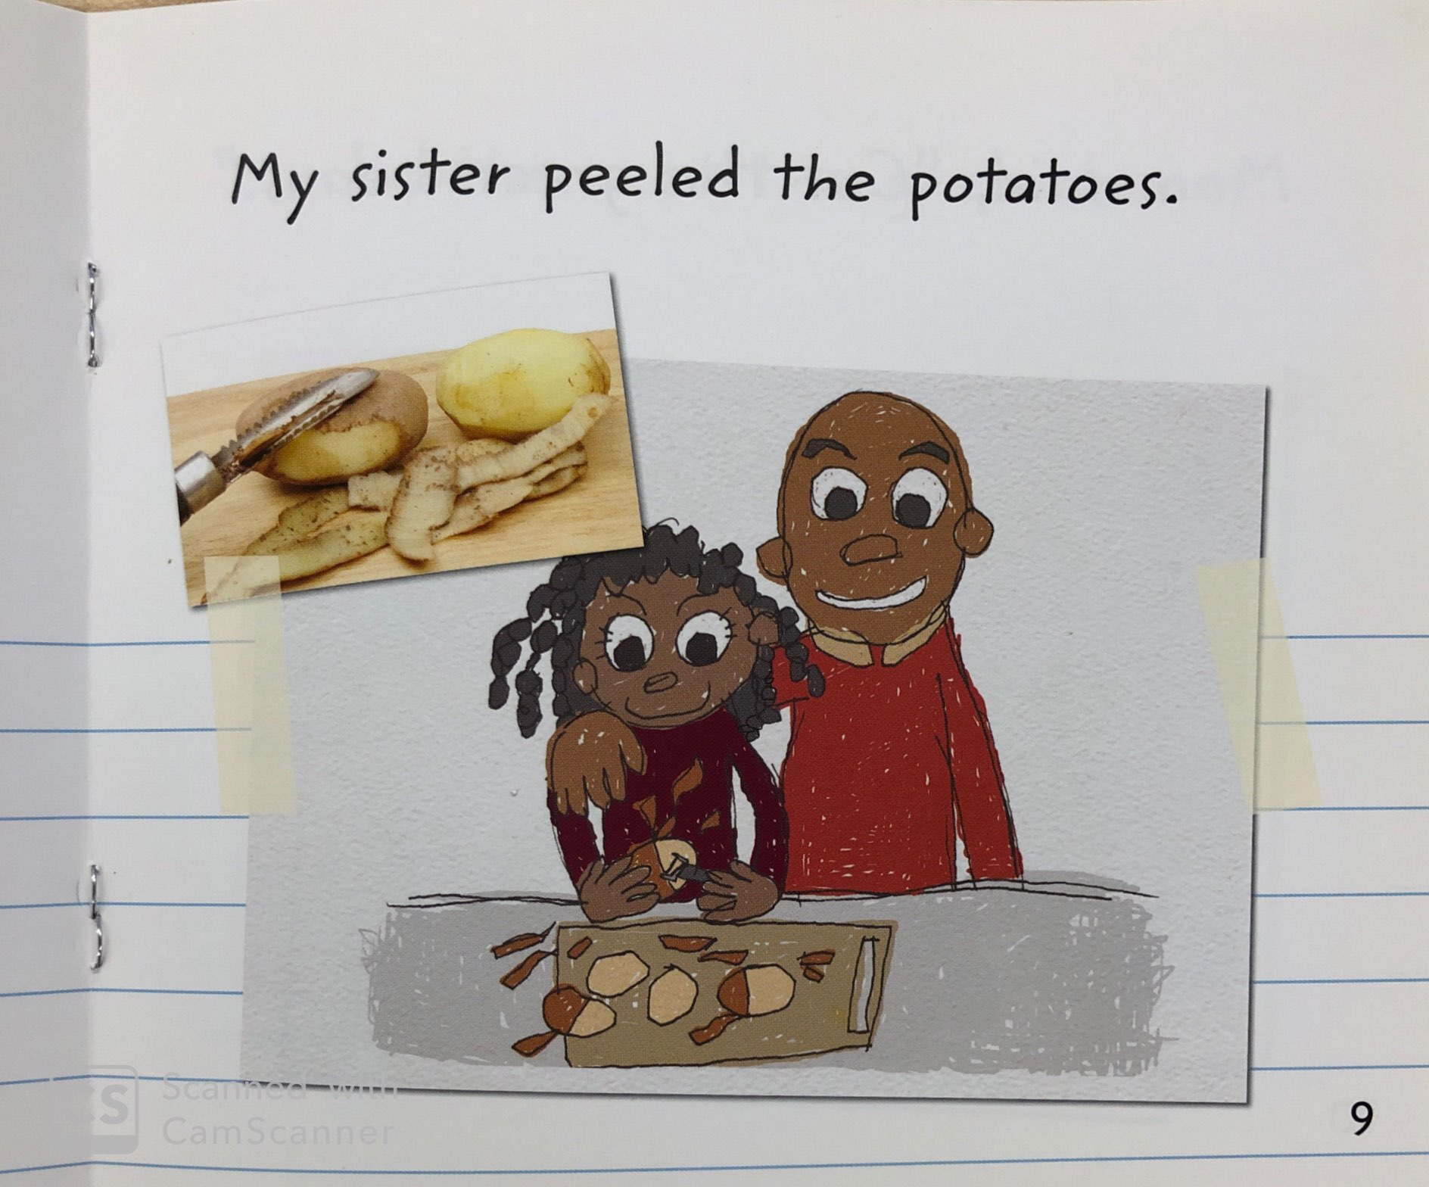
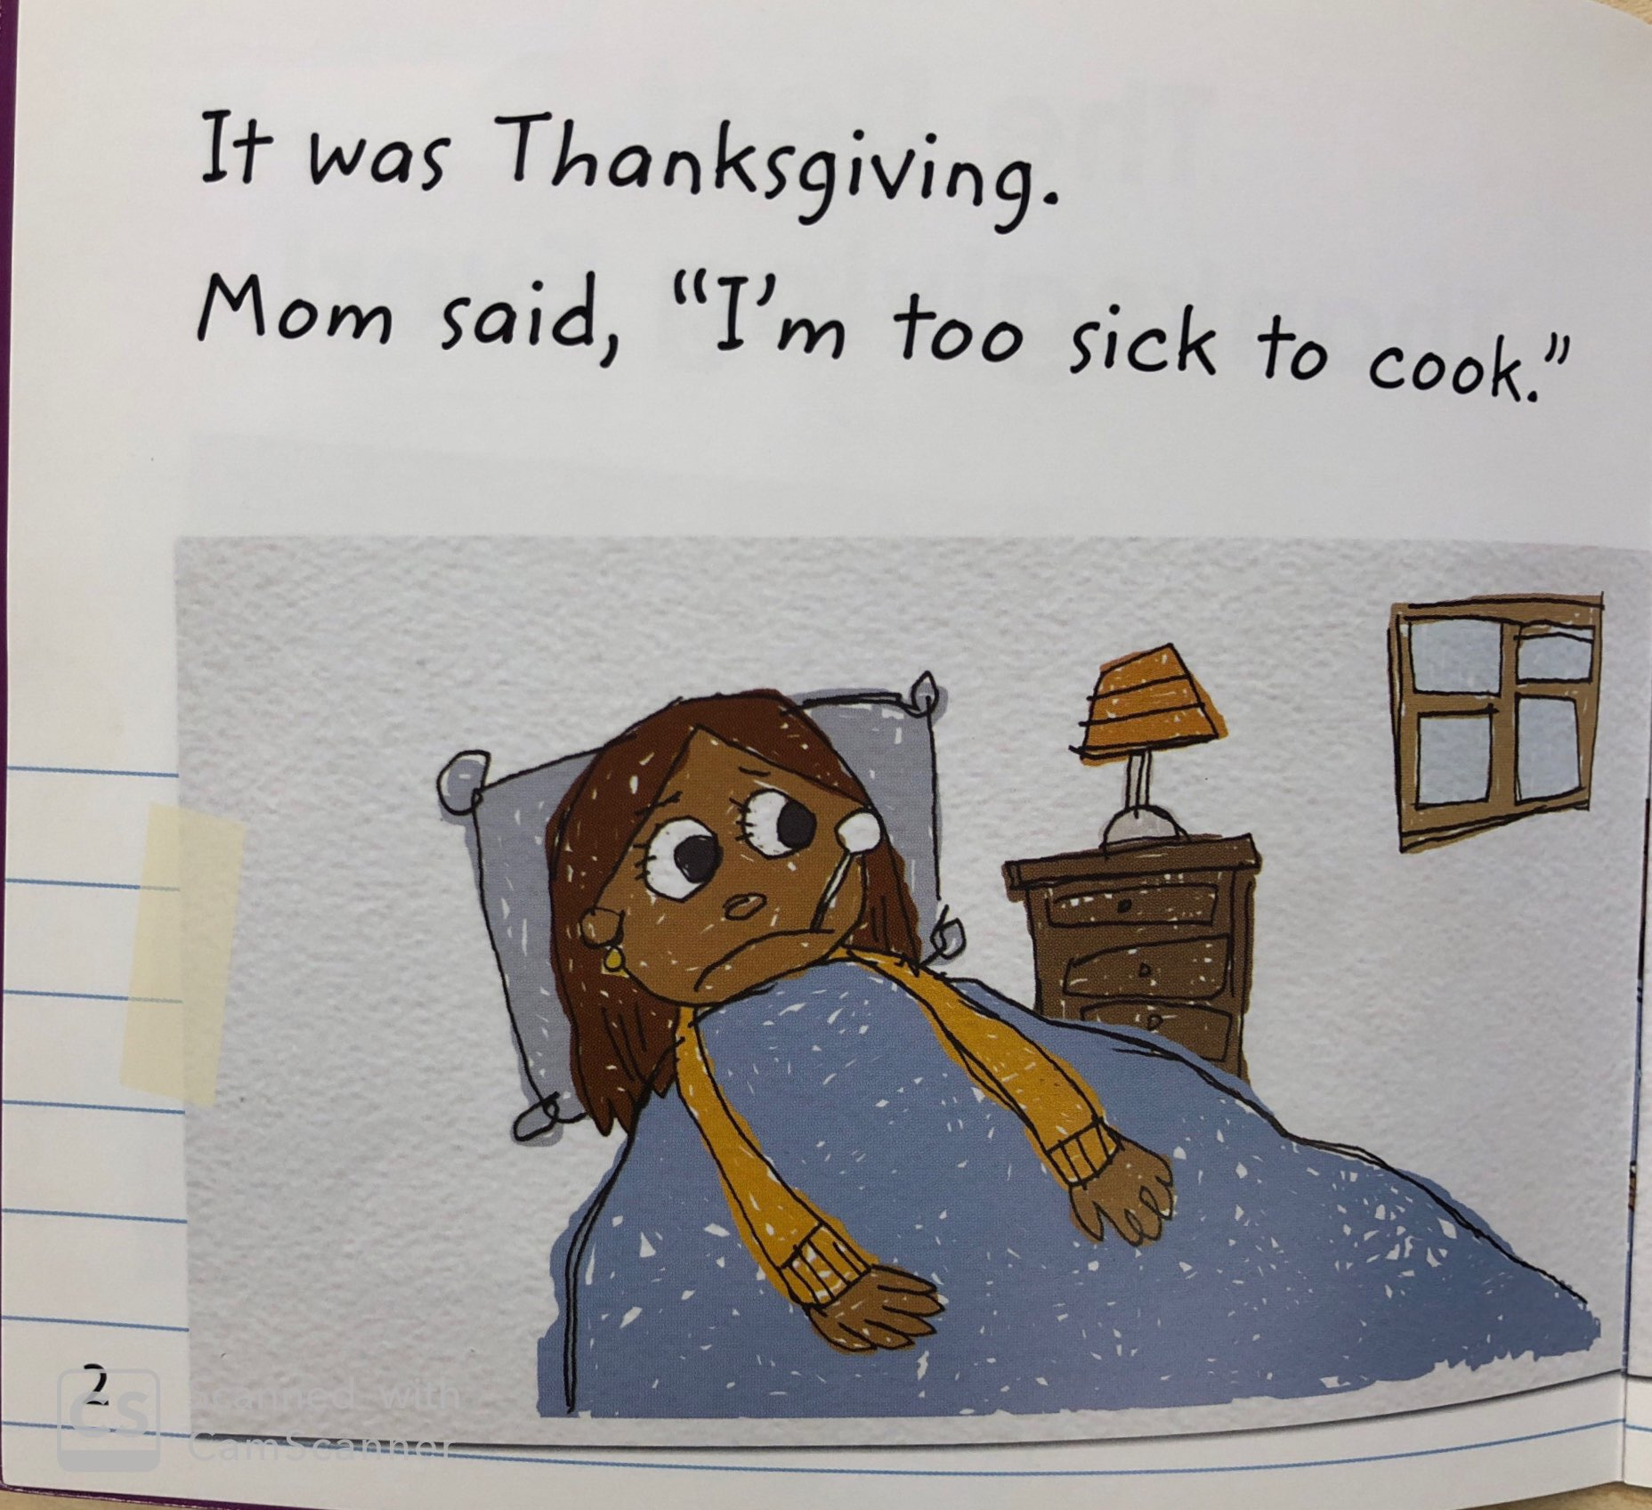
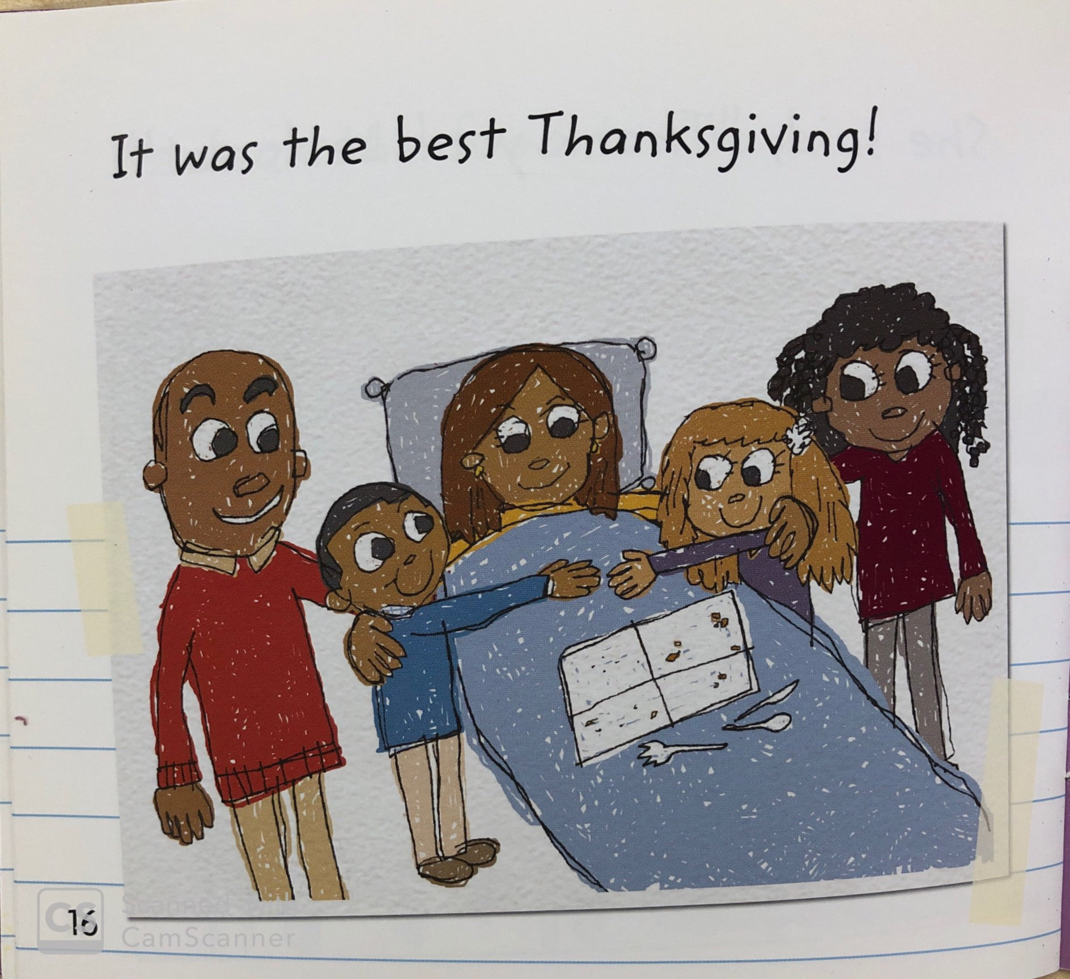
In “D” books, children begin to identify the story elements. They discuss characters, setting, beginning, middle, and end.

Slide 13
“D” books may contain dialogue between characters and elicit different feelings. There is less visual support for decoding.

Slide 14
What level is my child?
Children are assessed (tested) to determine what level is “just right.”
This includes
reading the words correctly
and
demonstrating comprehension

Slide 15
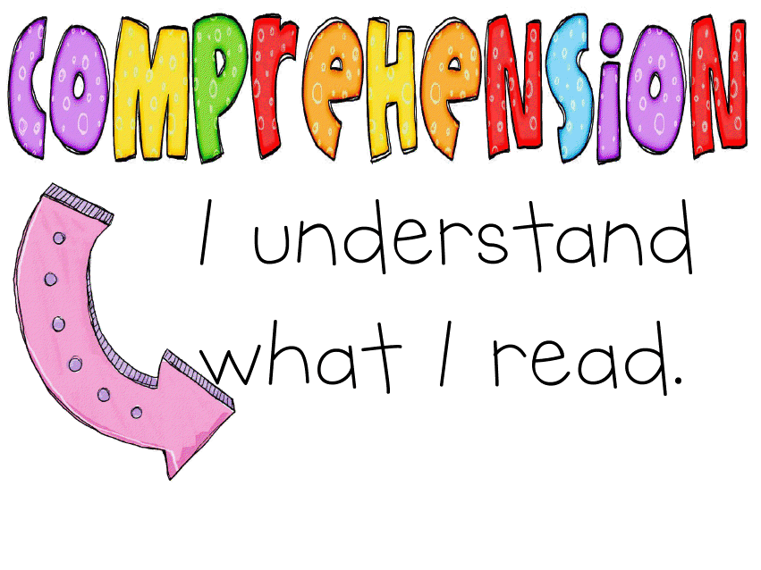
Children need to be able to answer some comprehension questions and retell key details of the story in order to move to the next reading level.

Slide 16
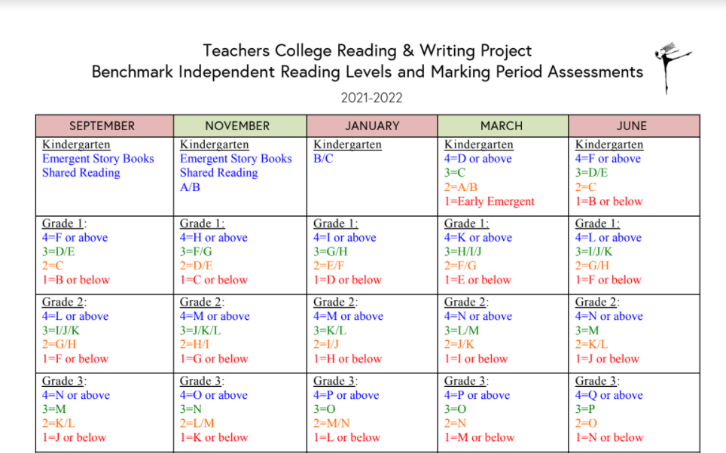
What level meets the standards?
(We’ll explain on the next slide.)

Slide 17
What did that chart mean?
Now, in December/January kindergarteners are expected to be in levels B or C.
By March the expectation is Level C.
In June, the expectation is Level D or E.

Slide 18
How Parents Can Help
with Just Right Books
Read the title to your child.
Discuss what the book might be about.
If A/B, read the first page to the child, pointing under the words.
Encourage your child to point under words as they read.
Remind your child to use the pictures to figure out tricky words.
If level C: Encourage them to look at the first (and last) letter.
Remember it is okay if your child says a wrong word, if it makes sense. Ask “What makes sense?” or “Does that make sense?”
Remember, sound-it-out is only one strategy.
Practice re-telling, at first by looking at pictures, then by memory. Ask, “What was the book about?”
Practice sight words: Use flashcards, find sight words in books you read to them, practice writing sight words.
Keep reading “Star” Books to them!

Slide 19
THANK YOU FOR COMING!
We hope that hearing
about how we use these books
has helped you
so you can help your child
become a stronger reader!

